Slide 1

Dept. of Computer Science and Engineering BRAC University CSE 341 Team
8086 Memory Banks

Slide 2
Lecture References:
Book:
Microprocessors and Interfacing: Programming and Hardware, Author: Douglas V. Hall
The 8086/8088 Family: Design, Programming, And Interfacing, Author: John Uffenbeck.

Slide 3
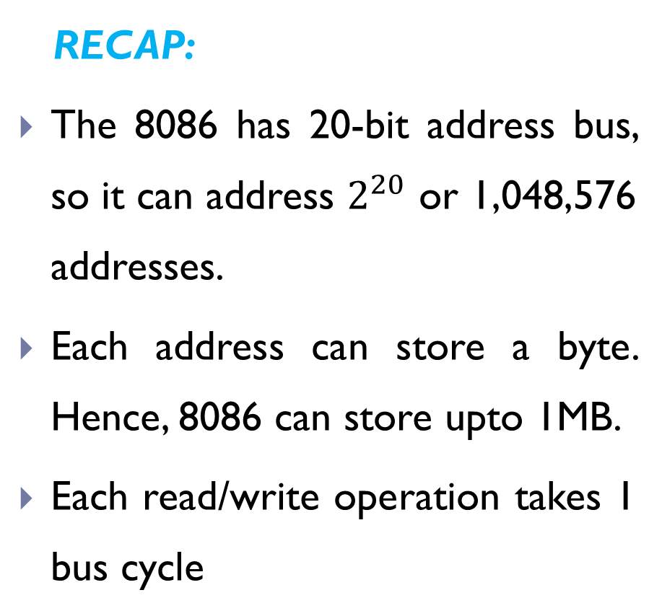
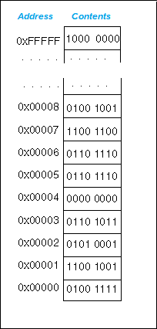
8086 Memory Organisation

Slide 4
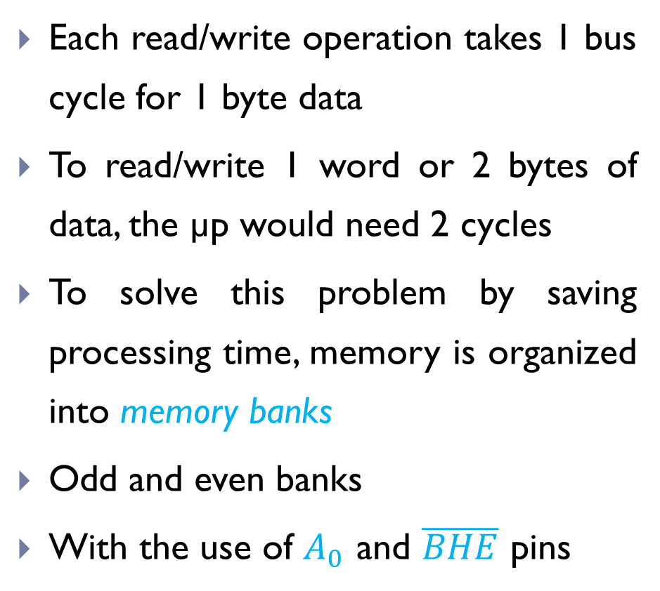
8086 Memory Organisation

Slide 5
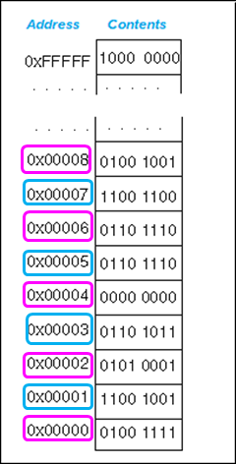
8086 Memory Organisation
Addresses are consecutively numbered
All even numbers end with a 0 and all odd numbers end with a 1
Even |  | Odd
6 = | 110 | 5 = | 101
14 = | 1110 | 13 = | 1101
20 = | 10100 | 27 = | 11011
42 = | 101010 | 35 = | 100011
even
odd

Slide 6
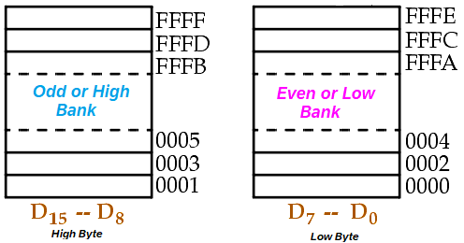
8086 Memory Organisation
Even addresses are considered as the even/low bank, which holds the content of the low byte while
Odd addresses are considered as the odd/high bank, which holds the content of the high byte

Slide 7
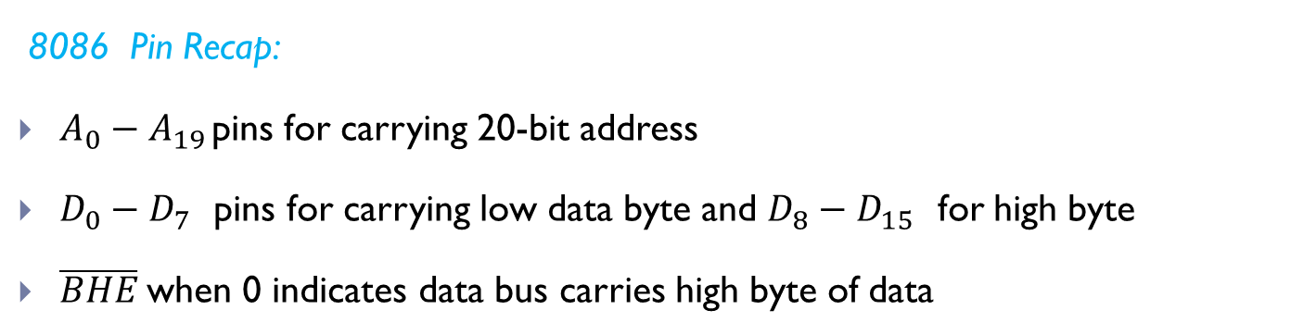
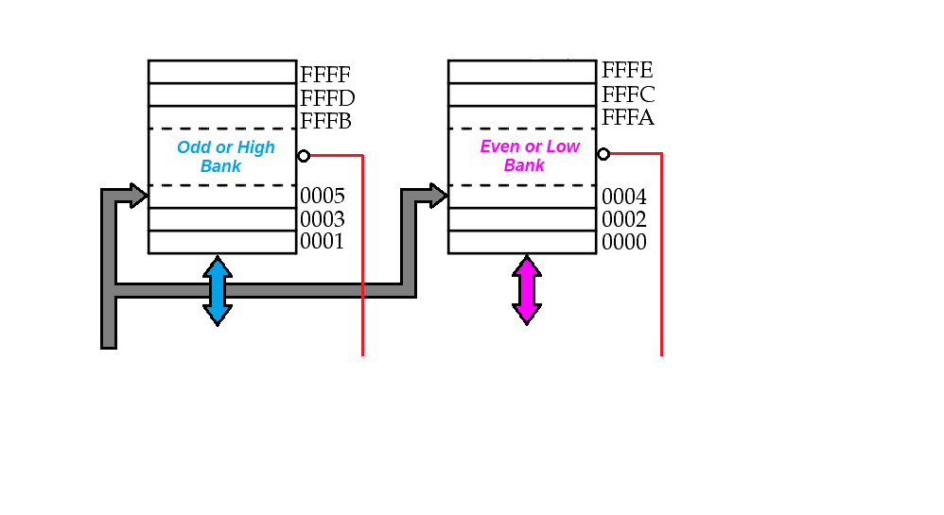





8086 Memory Banks
The memory for an 8086 is set up in to 2 banks of up to 524,288 bytes or 512kB each
This makes it possible to read/write a word with one machine cycle

Slide 8

8086 Memory Addressing
Data can be accessed from the memory in 4 different ways:
8 - bit data from Even Bank e.g. from address 00002
8 - bit data from Odd Bank e.g. from address 00003
16 - bit data starting from Even Address e.g. from 00002 and 00003
16 - bit data starting from Odd Address. e.g. from 00003 and 00004
 |  | Type of Transfer | Data Lines
0 | 0 | Word i.e. a byte from each bank
0 | 1 | Byte from odd bank
1 | 0 | Byte from even bank
1 | 1 | None | -

Slide 9
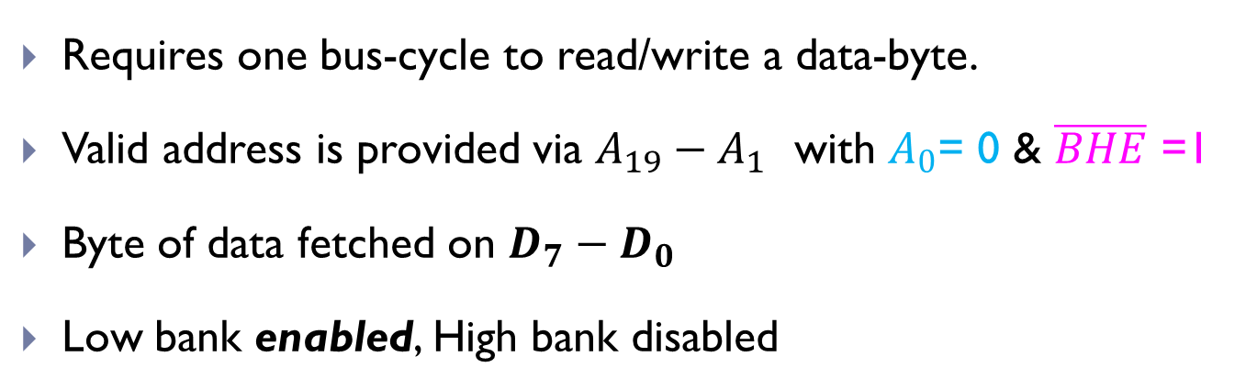



A byte from Low/Even bank
 |  | Type of Transfer | Data Lines
1 | 0 | Byte from even bank

Slide 10
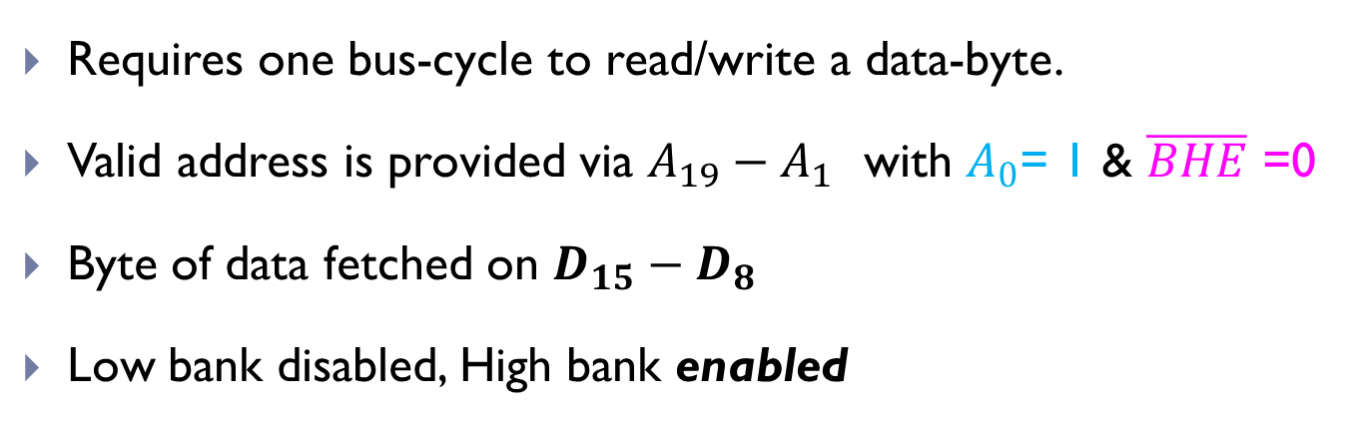


A byte from High/Odd bank
 |  | Type of Transfer | Data Lines
0 | 1 | Byte from odd bank

Slide 11
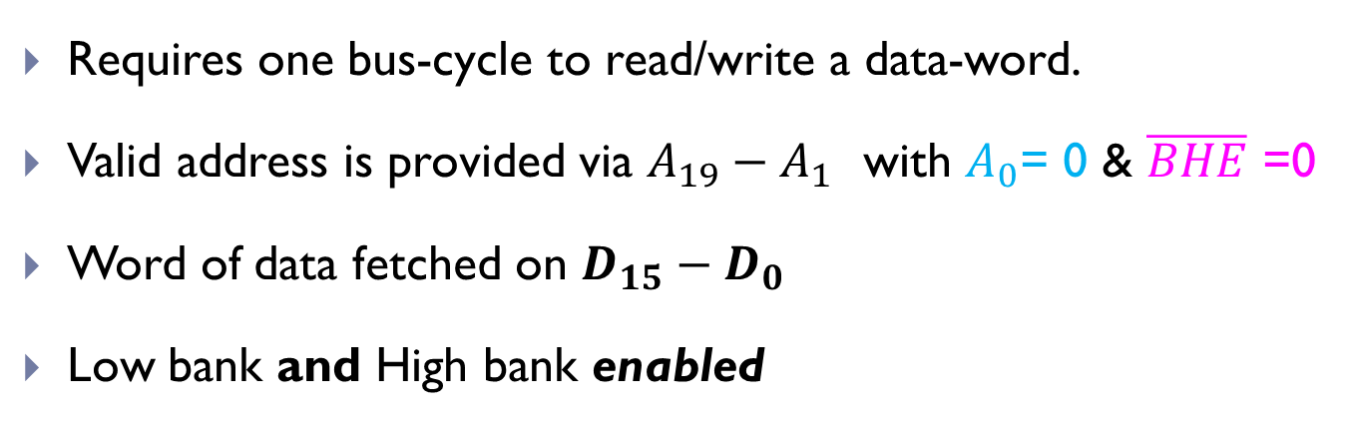


An aligned word starting from an even address
 |  | Type of Transfer | Data Lines
0 | 0 | Word i.e. a byte from each bank

Slide 12
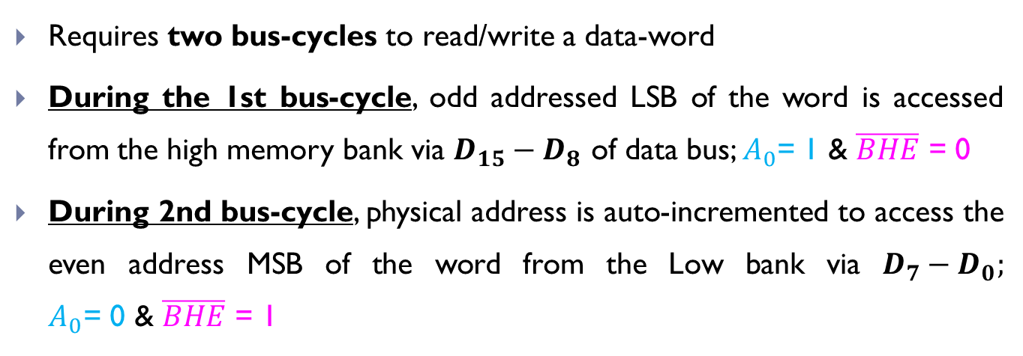






An unaligned word starting from an odd address
1
2

Slide 13
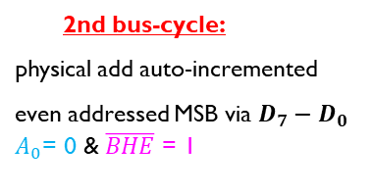
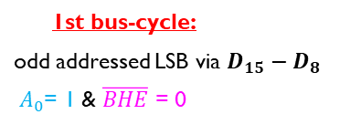


An unaligned word starting from an odd address
2 bus-cycles required

Slide 14
Thank You

